Slide 1
Introduction to WPF

Slide 2
What is WPF ?
Windows Presentation Foundation
Framework for building Windows desktop client Applications
Next-generation presentation system for building Windows client applications
Built to take advantage of modern graphics hardware
Part of .NET >= 3.0

Slide 3
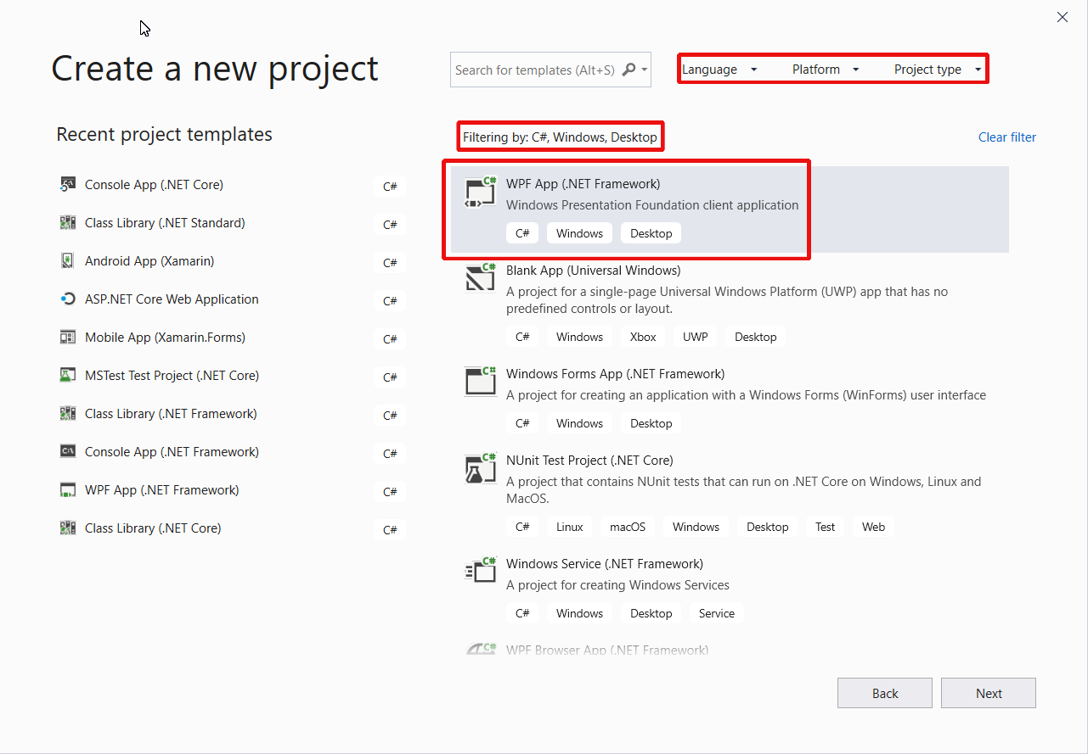
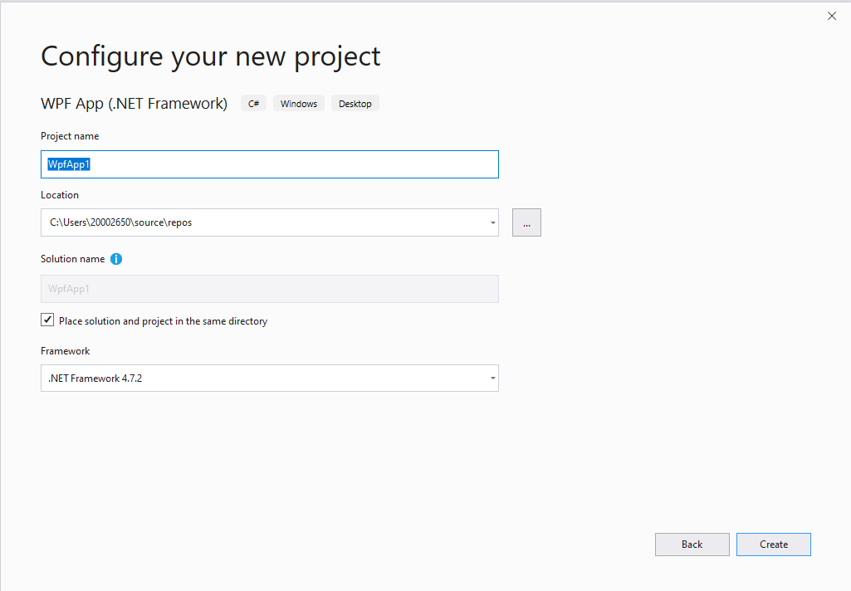
Create a WPF Project
Notes:
.NET Framework 4.7.2

Slide 4
What is WPF
Comprehensive set of application-development features:
Extensible Application Markup Language (XAML)
Controls
Data binding
Layout
2-D and 3-D graphics
Animation
Styles
Templates
Documents
Media
Tekst
Typography

Slide 5
What is WPF ?
Markup and Code-Behind
Appearance (UI)
XAML (Extensible Markup Language) by designers (Blend)
Behavior
C# by developers (Code-behind) (Visual Studio)
Notes:
WPF allows a seperation of the looks and the logic of the program

Slide 6
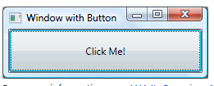
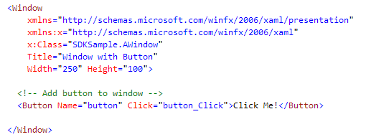
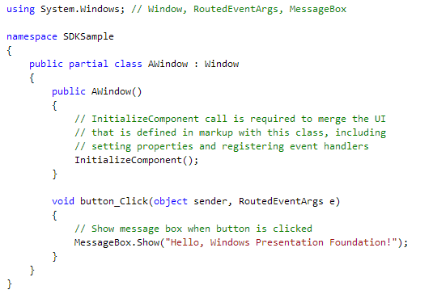
What is WPF ?
XAML
Code-Behind

Slide 7
What is XAML?
XAML = Extensible Application Markup Language
Pronounced “Zammel” (not Xammel !)
Set of tags loaded on the fly

Slide 8
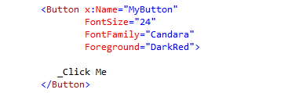

What is XAML?
Language for building .NET objects
Elements represent objects
Atributes represent objects’ property values

Slide 9
XAML: Elements
Objects that make up your UI
Objects are represented as elements
An object element declares an instance of a type
Each instance is created by calling the default constructor of the underlying type when parsing and loading the XAML.

Slide 10
XAML: Elements
Examples:
<Grid></Grid>
<Window></Window>
<StackPanel></StackPanel>
<Button Content = “Click me” />
…

Slide 11
XAML: Element Properties
Attribute Syntax :
An attribute names the property that is being set
Attribute value: always specified as a string (between “ “)
Example:
Notes:
This is the way we did it in .NET Essentials!

Slide 12
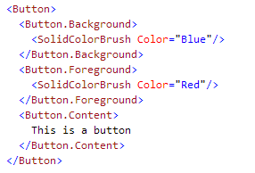
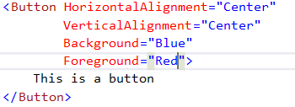
XAML: Element Properties
Alternative way: Property Element Syntax:
Different syntax used : <typeName.propertyName> </typeName.propertyName>
Sometimes optional, sometimes required (when the value is more than a simple string)
Examples:
Notes:
The property element syntax is an alternative way to declare attributes for an element.
Why do we need more than one way?
Because the attribute syntax is simple but limited to simple strings as values.
With the property element syntax we can define much more complex values for the attributes.

Slide 13
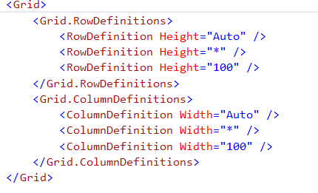
XAML: Element Properties
Property-element syntax
Also in grid definitions, this is required to be used

Slide 14
Attached Properties
Sometimes, we need to set properties from one control on another one
E.g. TextBlock that needs to go in first row and first column of the surrounding grid:

Slide 15
Attached properties
Grid defines itself in 4 “global” (attached) properties
Row Property
Column Property
RowSpan Property
ColumnSpan Property
Attached properties always are of the form <class>.<property>
They are called attached properties because they are defined by one class (in this case, Grid) but attached to other objects (in this case, children of the Grid)
Notes:
FYI:
Grid.Row=“0” causes the static method ‘Grid.SetRow’ to be called with the ‘TextBlock’ and 0 as parameters. See https://docs.microsoft.com/en-us/uwp/api/windows.ui.xaml.controls.grid.setrow
Grid.Column=“0” causes the static method ‘Grid.SetColumn’ to be called. See https://docs.microsoft.com/en-us/uwp/api/windows.ui.xaml.controls.grid.setcolumn

Slide 16
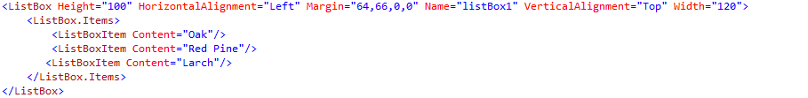
XAML: Collection syntax
Items that you declare in markup as child elements become part of the collection
The type of the content property must be a collection type.
Example:
Notes:
In the example above the content property is an instance of System.Windows.Controls.ItemCollection (<ListBox.Items></ListBox.Items>).

Slide 17


XAML: Content Property
Content property values must be contigious
Illegal:
Why? If this syntax were made explicit by using property element syntax, then the content property would be set twice:

Slide 18
XAML: Elements and attributes
Elements can be nested
‘x:Class= ‘ : name of the Window’s class
‘xmlns: ‘ : equivalent to the ‘using’ statement
‘xmlns:x= ‘ : additional XAML namespace
To access the elements of this namespace → prefix element with x:
xmlns attributes:
only necessary on root element → will apply to all descendant elements of the root element
permitted on other elements

Slide 19
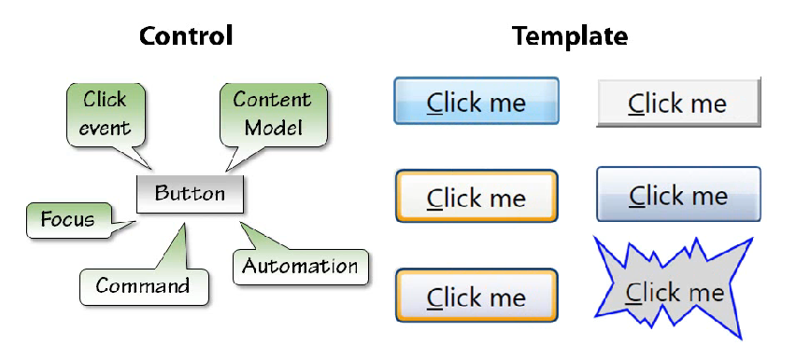
Controls
WPF controls are lookless: no instrinsic look
Appearance is provided by the template

Slide 20
Controls
Control doesn’t have a fixed look
Controls has custom look typical for the application
Control seperated into 2 parts:
the look (template)
everything else, defined by the control itself

Slide 21
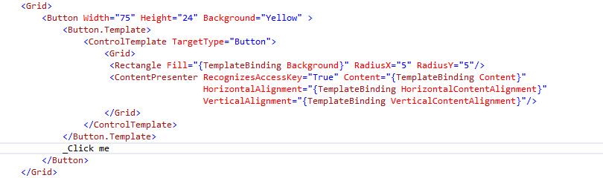
Controls
{}: not a normal property value → Markup Extension = objects that decide at run time how the property is going to be set
Notes:
We’ll be using this a lot when we talk about Databinding

Slide 22
Layout: Container Controls
built-in layout and positioning functionality
Simular to the use of components and layout managers in Java Swing.
Grid (see Gridlayout in Java Swing)
Canvas (See Canvas component in Java Swing)
StackPanel (see Flowlayout in Java Swing)
DockPanel (see Borderlayout in Java Swing)
TabControl (JTabbedPane in Java Swing)
…

Slide 23
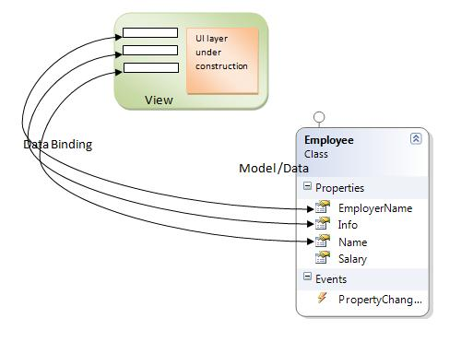
Data binding
Windows Presentation Foundation (WPF) data binding provides a simple and consistent way for applications to present and interact with data. Elements can be bound to data from a variety of data sources

